Slide 1

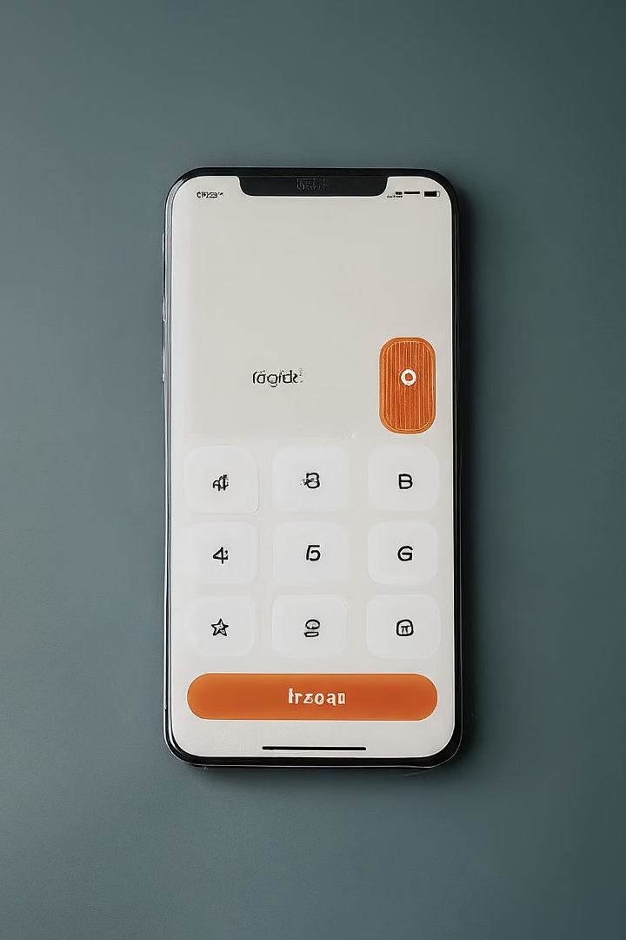

Java Calculator
Developing a user-friendly calculator application in Java, focusing on a modern and intuitive graphical interface with a wide range of arithmetic functions.
by Awais

Slide 2
Project Overview
Graphical User Interface
Arithmetic Functionality
Additional Features
Implementing advanced features like decimal input, clear, delete, and negative number handling to enhance the calculator's usability.
The calculator will be built using Java Swing, creating a clean and responsive interface with a text field for input/output and buttons for digits and operations.
The application will support basic arithmetic operations, allowing users to perform calculations with ease and precision.

Slide 3
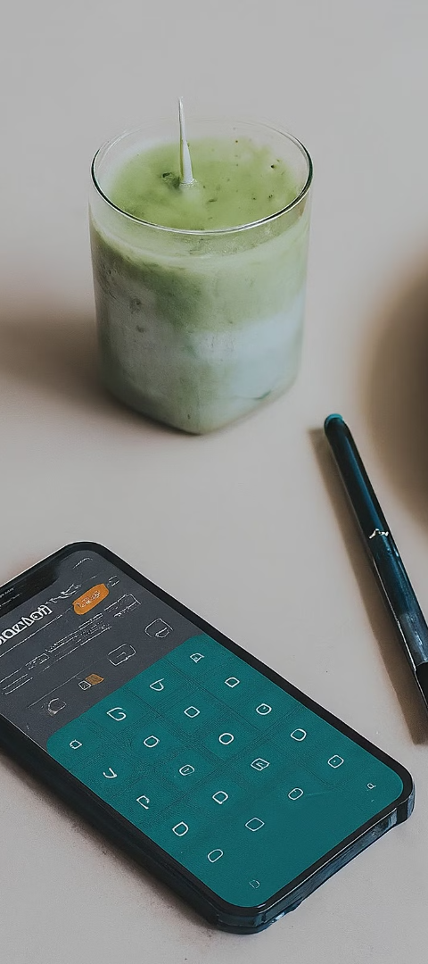
GUI Design
1
Main Window
The calculator's main window will be a JFrame, utilizing a GridLayout for the number buttons and a FlowLayout for the operation buttons.
2
Text Field
The text field will be a JTextField that is not editable, allowing the application to update the display with the user's inputs and calculations.
3
Aesthetic Approach
The design will focus on simplicity and ease of use, with a modern and clean visual aesthetic to enhance the user experience.

Slide 4




Arithmetic Functionality
Input Handling
When a number button is pressed, the corresponding digit will be appended to the text field. Operation buttons will store the current number and set the operation to be performed.
Calculation Logic
Pressing the equals button will perform the selected operation on the stored number and the current number in the text field, displaying the result.
Seamless Experience
The calculator will provide a smooth and intuitive user experience, allowing for effortless input and calculation of basic arithmetic operations.

Slide 5
Advanced Features
1
Decimal Point
2
Clear Function
Users can input decimal numbers by detecting the decimal point button press and appending it to the current number in the text field.
The clear button will reset the calculator to its initial state by setting the text field's content to an empty string.
3
Delete
4
Negative Numbers
The delete button will remove the last character from the text field, allowing users to correct any input mistakes.
The calculator will support negative numbers by detecting the negative button press and appending a negative sign to the current number in the text field.

Slide 6

Conclusion
Comprehensive Functionality
Intuitive Design
The calculator application will provide a wide range of arithmetic operations and advanced features, catering to the diverse needs of users.
The focus on simplicity and ease of use will ensure that the calculator is accessible and enjoyable for users of all ages and skill levels.
Future Enhancements
The project serves as a foundation for future improvements, allowing for the exploration of more complex features and the enhancement of the application's overall performance.

Slide 7



Benefits for Students
Learning Opportunities
Practical Application
Strengthened Portfolio
This project provides valuable insights into GUI development, object-oriented programming, and problem-solving in software engineering.
The hands-on experience of building a calculator app helps solidify programming concepts and fosters practical skills.
Successful completion of this project can be a valuable addition to a student's portfolio, showcasing their programming abilities.

